Slide 1
Memory Management

Slide 2
Memory Management
Subdividing memory to accommodate multiple processes
Memory needs to be allocated to ensure a reasonable supply of ready processes to consume available processor time

Slide 3
Memory Management Requirements
Relocation
  Programmer does not know where the program will be placed in memory when it is executed
  While the program is executing, it may be swapped to disk and returned to main memory at a different location (relocated)
  Memory references must be translated in the code to actual physical memory address

Slide 4
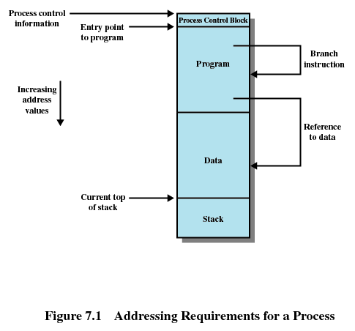

Slide 5
Memory Management Requirements
Protection
  Processes should not be able to reference memory locations in another process without permission
  Impossible to check absolute addresses at compile time
  Must be checked at rum time
  Memory protection requirement must be satisfied by the processor (hardware) rather than the operating system (software)
    Operating system cannot anticipate all of the memory references a program will make

Slide 6
Memory Management Requirements
Sharing
  Allow several processes to access the same portion of memory
  Better to allow each process access to the same copy of the program rather than have their own separate copy

Slide 7
Memory Management Requirements
Logical Organization
  Programs are written in modules
  Modules can be written and compiled independently
  Different degrees of protection given to modules (read-only, execute-only)
  Share modules among processes

Slide 8
Memory Management Requirements
Physical Organization
  Memory available for a program plus its data may be insufficient
    Overlaying allows various modules to be assigned the same region of memory
  Programmer does not know how much space will be available

Slide 9
Memory management techniques
tablas\OS5e-PDF-Tables\T07-Vertical.pdf

Slide 10
Fixed Partitioning
Equal-size partitions
  Any process whose size is less than or equal to the partition size can be loaded into an available partition
  If all partitions are full, the operating system can swap a process out of a partition
  A program may not fit in a partition. The programmer must design the program with overlays

Slide 11
Fixed Partitioning
Main memory use is inefficient. Any program, no matter how small, occupies an entire partition. This is called internal fragmentation.

Slide 12
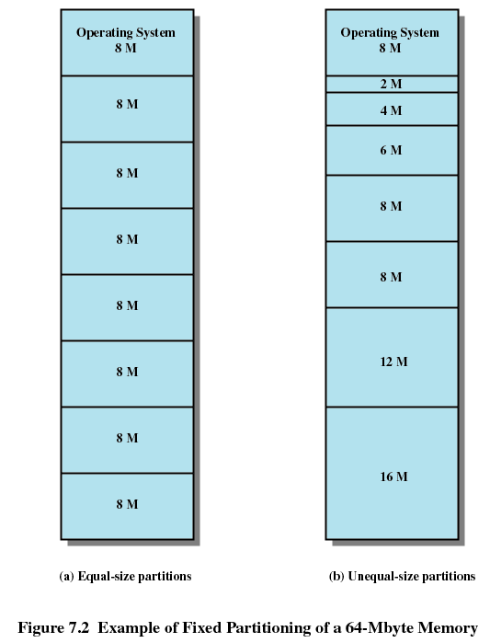

Slide 13
Placement Algorithm with Partitions
Equal-size partitions
  Because all partitions are of equal size, it does not matter which partition is used
Unequal-size partitions
  Can assign each process to the smallest partition within which it will fit
  Queue for each partition
  Processes are assigned in such a way as to minimize wasted memory within a partition

Slide 14
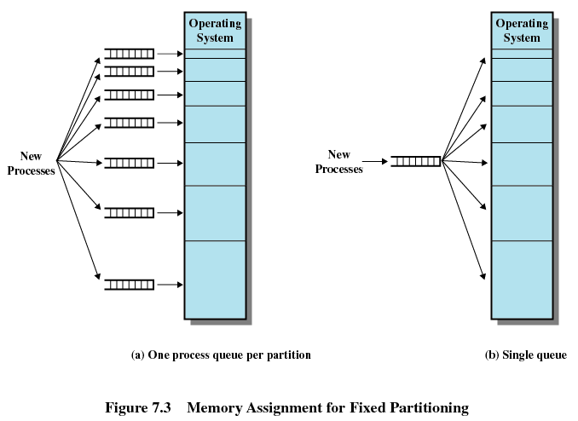

Slide 15
Dynamic Partitioning
Partitions are of variable length and number
Process is allocated exactly as much memory as required
Eventually get holes in the memory. This is called external fragmentation
Must use compaction to shift processes so they are contiguous and all free memory is in one block

Slide 16
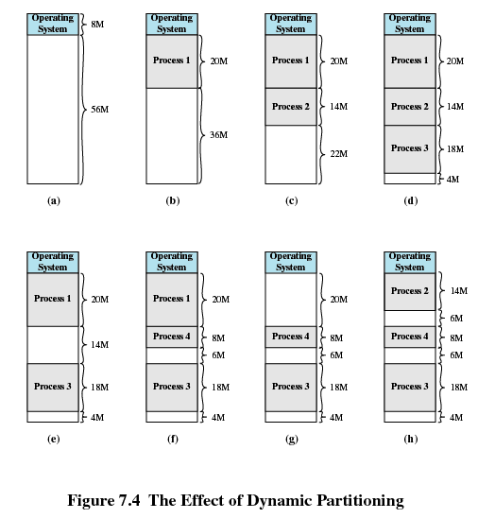

Slide 17
Dynamic Partitioning Placement Algorithm
Operating system must decide which free block to allocate to a process
Best-fit algorithm
  Chooses the block that is closest in size to the request
  Worst performer overall
  Since smallest block is found for process, the smallest amount of fragmentation is left
  Memory compaction must be done more often

Slide 18
Dynamic Partitioning Placement Algorithm
First-fit algorithm
  Scans memory form the beginning and chooses the first available block that is large enough
  Fastest
  May have many process loaded in the front end of memory that must be searched over when trying to find a free block

Slide 19
Dynamic Partitioning Placement Algorithm
Next-fit
  Scans memory from the location of the last placement
  More often allocate a block of memory at the end of memory where the largest block is found
  The largest block of memory is broken up into smaller blocks
  Compaction is required to obtain a large block at the end of memory

Slide 20
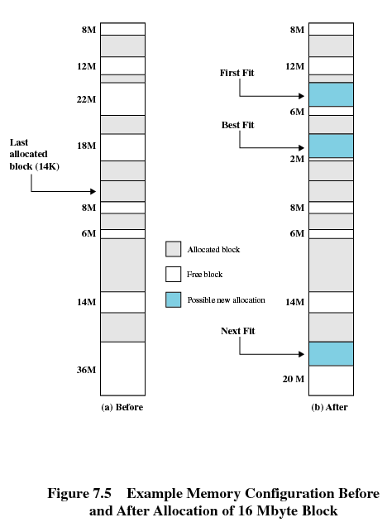

Slide 21
Buddy System
Entire space available is treated as a single block of 2^{U}
If a request of size s such that 2^{U-1} < s <= 2^{U}, entire block is allocated
  Otherwise block is split into two equal buddies
  Process continues until smallest block greater than or equal to s is generated

Slide 22
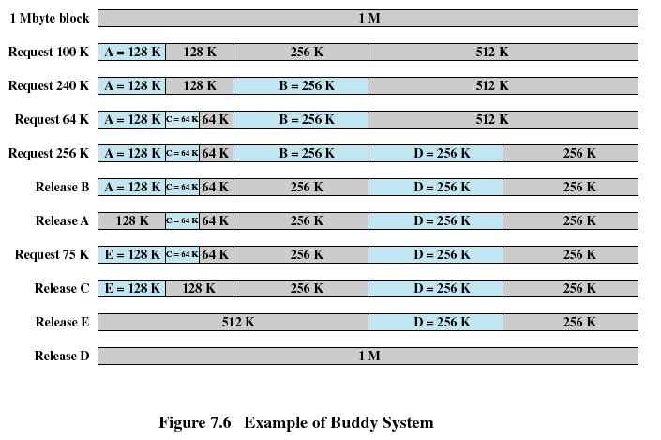

Slide 23
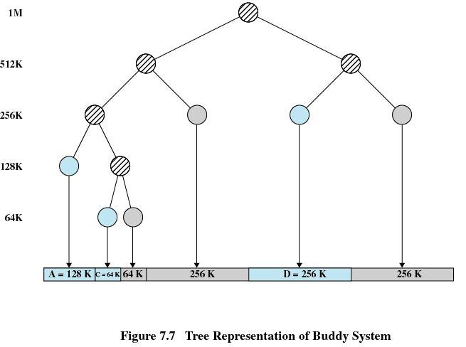

Slide 24
Relocation
When program loaded into memory the actual (absolute) memory locations are determined
A process may occupy different partitions which means different absolute memory locations during execution (from swapping)
Compaction will also cause a program to occupy a different partition which means different absolute memory locations

Slide 25
Addresses
Logical
  Reference to a memory location independent of the current assignment of data to memory
  Translation must be made to the physical address
Relative
  Address expressed as a location relative to some known point
Physical
  The absolute address or actual location in main memory

Slide 26
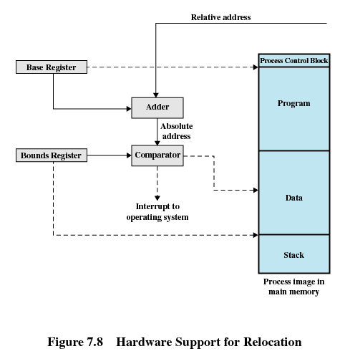

Slide 27
Registers Used during Execution
Base register
  Starting address for the process
Bounds register
  Ending location of the process
These values are set when the process is loaded or when the process is swapped in

Slide 28
Registers Used during Execution
The value of the base register is added to a relative address to produce an absolute address
The resulting address is compared with the value in the bounds register
If the address is not within bounds, an interrupt is generated to the operating system

Slide 29
Paging
Partition memory into small equal fixed-size chunks and divide each process into the same size chunks
The chunks of a process are called pages and chunks of memory are called frames
Operating system maintains a page table for each process
  Contains the frame location for each page in the process
  Memory address consist of a page number and offset within the page

Slide 30
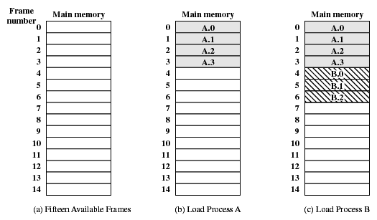
Assignment of Process Pages to Free Frames

Slide 31
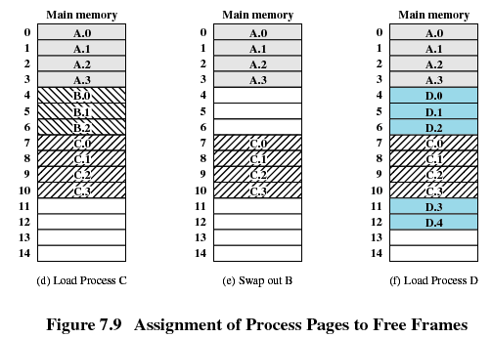
Assignment of Process Pages to Free Frames

Slide 32
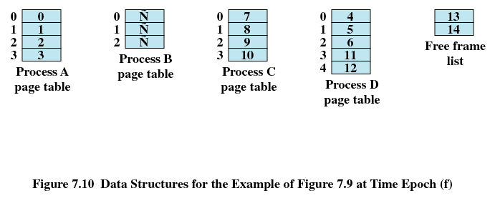
Page Tables for Example

Slide 33
Segmentation
All segments of all programs do not have to be of the same length
There is a maximum segment length
Addressing consist of two parts - a segment number and an offset
Since segments are not equal, segmentation is similar to dynamic partitioning

Slide 34
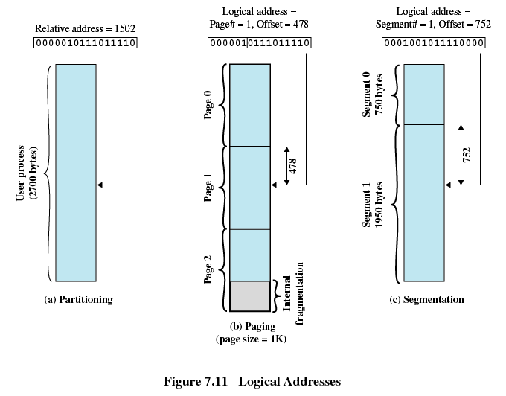

Slide 35
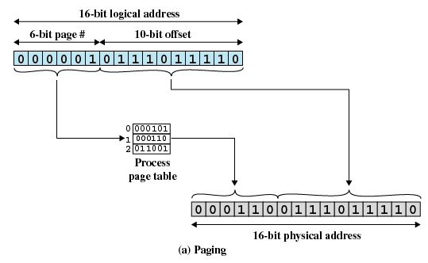

Slide 36
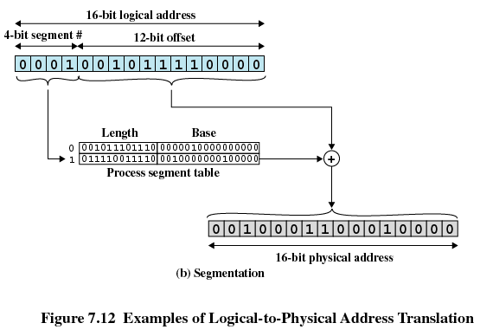

Slide 37
Practice questions.
Usando particionamiento dinámico y la memoría en un momento específico es como muestra la figura.
Si llegan petiticiones de memoria de 40M, 20M y 10M. Indique la dirección inicial en los siguientes algoritmos:
Primer ajuste
Mejor Ajuste
Peor Ajuste
40M
4
0M
60M
40M
30M
40M
40M

Slide 38
